Slide 1
Disaster In Your Floodplain? You’ll Want These
Public Assistance Dollars
Louisiana Emergency Management Conference | May 2024
Notes:
Rebecca
Session on Wednesday, May 8, 10:15-11:30 am
Presenters: FEMA Floodplain, FEMA PA, GOHSEP PA, and LADOTD Floodplain, so we can hit it from the FEMA and state perspective. If a community representative (maybe an EM or floodplain administrator) from a community who has sought/received the reimbursement wanted to provide their perspective too, we could consider that to add the local perspective.

Slide 2
Newish PA Reimbursement—What Is It?
Policy effective date November 1, 2020
Notes:
Nathan & Eddie
Remind or let participants know there is newish PA money out there to do your local post-disaster Building Code/Floodplain admin/enforcement job (DRRA Section 1206 Section 1206 | Building Code and Floodplain Management Administration and Enforcement).
The Disaster Recovery Reform Act of 2018 (DRRA), amended Sections 402 and 406 of the Robert T. Stafford Disaster Relief and Emergency Assistance Act (Stafford Act), and authorized FEMA to “provide assistance to state and local governments for building code and floodplain administration and enforcement, including inspections for substantial damage compliance”1 and “base and overtime wages for extra hires to facilitate the implementation and enforcement of adopted building codes for a period of not more than 180 days after the major disaster is declared.” 2 This policy enacted through FEMA’s Public Assistance (PA) Program implements section 1206 of DRRA by leveraging the amendments to Section 402 and Section 406. While the provisions of this policy apply only to the PA Program, assistance under section 1206 of DRRA may be available under other FEMA programs, such as FEMA’s Federal Insurance and Mitigation Administration’s (FIMA) Substantial Damage Data Collection Contracts

Slide 3



Who, what, when?
Authorizes FEMA to provide NFIP Communities in good standing with reimbursement to administer and enforce adopted building codes and floodplain ordinances. Must have legal authority over administration/enforcement
  Typically, will be a parish, tribe, city, town, village, etc.
Funding support can be provided during FEMA PA major disaster declarations for permanent work categories C-G, captured as a Category G “Other” (see FAQ2, page 4) projects. Subject to prevailing cost share
  Category G is a catch all category (parks/recreation, facilities that don’t fit other categories)
To administer and enforce adopted building codes and floodplain ordinances in disaster-damaged areas for the 180 days directly following the PA permanent work declaration date. Reimbursement period can start on the first day of the incident period (see FAQ2, page 2)
Notes:
Nathan & Eddie
TO BE ELIGIBLE FOR PUBLIC ASSISTANCE GRANT FUNDING MADE AVAILABLE THROUGH DRRA 1206, STATE, LOCAL, TRIBAL OR TERRITORIAL GOVERNMENTS MUST:
☑ Be in good standing with the National Flood Insurance Program
☑ Be authorized for assistance under a major disaster declaration
☑ Be legally responsible for administering and enforcing adopted building codes and floodplain management regulations
☑ Report list of impacts to FEMA within 60 days of the Recovery Scoping Meeting
☑ Submit supporting documentation through the Public Assistance Grants Portal

Slide 4
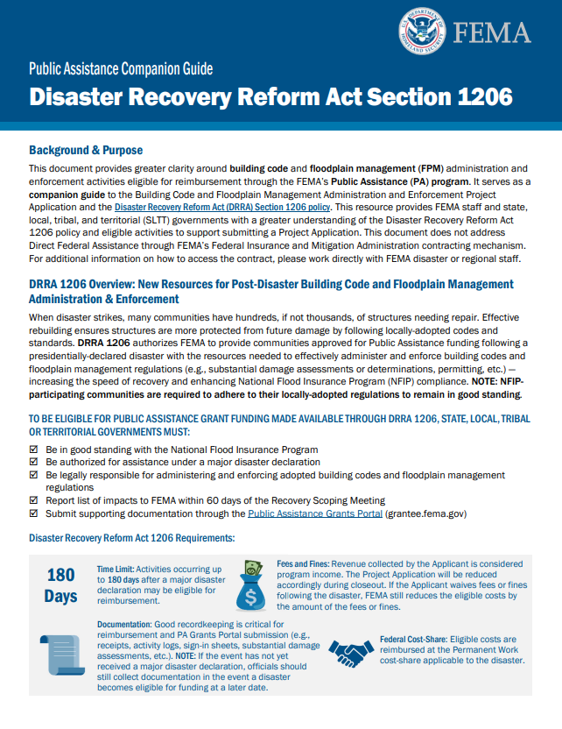
Disaster Recovery Reform Act (DRRA), Section 1206
Provides communities with resources to administer and enforce building code and floodplain management regulations by reimbursing eligible work and costs through FEMA’s Public Assistance (PA) program
Hundreds or thousands of damaged structures may need repairs, permits, and inspections in your community after a disaster
Funding is limited to 180 days following a major disaster declaration for PA Categories C–G, reimbursed at the permanent work cost-share applicable to the disaster
Public Assistance Companion Guide Disaster Recovery Reform Act Section 1206 (fema.gov)
4
Notes:
Nathan & Eddie
When disaster strikes, many communities have hundreds, if not thousands, of structures needing repair. Effective rebuilding ensures structures are more protected from future damage by following locally-adopted codes and standards. DRRA 1206 authorizes FEMA to provide communities approved for Public Assistance funding following a presidentially-declared disaster with the resources needed to effectively administer and enforce building codes and floodplain management regulations (e.g., substantial damage assessments or determinations, permitting, etc.) — increasing the speed of recovery and enhancing National Flood Insurance Program (NFIP) compliance. NOTE: NFIP participating communities are required to adhere to their locally-adopted regulations to remain in good standing.
Disaster Recovery Reform Act of 2018 (DRRA), amended Sections 402 and 406 of the Robert T. Stafford Disaster Relief and Emergency Assistance Act (Stafford Act), and authorized FEMA to “provide assistance to state and local governments for building code and floodplain administration and enforcement, calls out specifically inspections for substantial damage compliance.

Slide 5
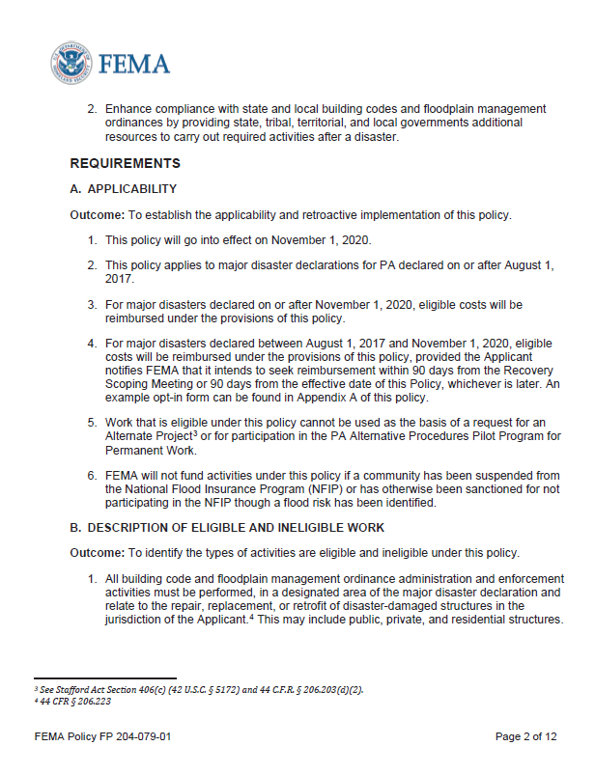

Work Eligibility Criteria
Must be:
Performed in a designated area of the major disaster declaration and;
Relate to the repair, replacement or retrofit of disaster-damaged structures (public, private and residential) in the jurisdiction of the Applicant
Consistent with the work normally done to administer and enforce building codes
Notes:
Nathan & Eddie

Slide 6
Eligible work (see policy for longer list, non-listed evaluated case-by-case)
Building Code Administration & Enforcement
Floodplain Management Administration & Enforcement
Substantial Damage Determinations
Review and process applications for building permits; certificates of occupancy; certificates of compliance
Hire, train, supervise, certify, and license staff, as required to conduct eligible activities
Provide training and outreach to the public on building code and building permit requirements
Establish construction plan review and inspection processes, procedures, and instructions for permit holders
Inspect structures
Monitor impacted areas for unpermitted construction activities
Identify and carry out corrective actions
Review and issue elevation certificates
Process disaster-related floodplain permits
Provide public training, info & outreach on compliance
Review disaster-related development for compliance
Hire, train, supervise, license staff
Inspect all disaster-related development
Monitor impacted areas for unpermitted construction activities
Process, maintain, and track temporary occupancy permits and inspect temporary occupancy buildings
Provide training and information to staff, contractors, and the public on unique considerations for repair of disaster-damaged historic buildings
Conduct initial substantial damage (SD) field surveys
Prepare repair cost and market value estimates for SD
Enter damage inventory administrative data into the Substantial Damage Estimator or comparable data collection software
Track cumulative SD and repetitive loss, if required
Hire, train, supervise, license staff
Inform property owners of damage determination and provide compliance requirements
Review, adjudicate, and resolve Substantial Damage Determination appeals
Notes:
Nathan & Eddie
Note the eligible work bullets are not all-inclusive. For a longer list, please see the policy. Activities not listed in the policy will be evaluated on a case-by-case basis.

Slide 7
Eligible costs
Overtime for budgeted employees
Straight and overtime for unbudgeted employees & extra hires
Costs associated with temporary hires or contract support is eligible
Other costs associated with extra hires or contracted support may be eligible for reimbursement. This includes costs for travel, accommodations, and per diem, as appropriate
Purchase of supplies and equipment to execute work is eligible
Mutual Aid or EMAC costs are eligible depending on agreement
Legal cost related to enforcing building code or floodplain ordinance
  *Fees and fines are considered project income and worksheets will be reduced accordingly during closeout.
Notes:
Nathan & Eddie

Slide 8

Community Requirements
Communities must submit their applications for reimbursement and all supporting documentation through the PA Grants Portal
Supporting documentation is needed to:
  Demonstrate completed work,
  Demonstrate costs incurred,
  Location of work,
  Validate EMAC resource requests or intrastate/interlocal mutual aid requests
  Legal authority for floodplain management or building codes
Notes:
Nathan & Eddie
Slide Objective: Provide an overview of community requirements to receive support
FEMA provides technical assistance to individuals using PA Grants Manager and Grants Portal via a Help Line at 1-866-337-8448 and email correspondence at FEMA-Recovery-PA-Grants@fema.dhs.gov.
Communities must submit their applications for reimbursement and all supporting documentation through the PA Grants Portal.
To receive funding, applicants must submit the following documentation to FEMA:
All supporting documentation necessary to demonstrate work completed or estimated task and cost for work to be completed.
All documentation associated with work that was completed through an Emergency Management Assistance Compact (EMAC) resource request or intrastate/interlocal mutual aid request.
This could include a cost breakdown of total costs, the applicant’s accounting of expenditures, procurement documents, or any documentation that allows FEMA to validate the work performed.
Supporting documentation is needed to:
Demonstrate completed work,
Demonstrate location of work, and
Validate EMAC resource requests or intrastate/interlocal mutual aid requests.
Again, these are the community requirements in order to receive support under DRRA 1206.

Slide 9
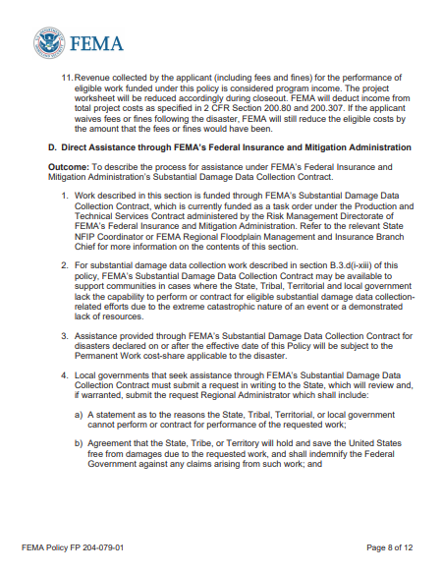

Non-PA Part of Policy (Direct Assistance Contract)
Generally, FEMA or FEMA contractors will NOT be conducting substantial damage floodplain assessments for communities, like they’ve done in past disasters
Part D, Direct Assistance, in the policy allows for requesting FEMA’s Federal Insurance and Mitigation Administration contracting mechanism for SD inspections due to extreme disaster nature/lack of community resources. Requirements outlined in policy
The fastest, most cost-effective route for communities to take will be to position themselves to be able to conduct or contract out on their own for inspections
Notes:
Chad
Being able to conduct these SD inspections quickly after a disaster is key to ensuring that citizens know any rebuilding requirements before they start to make repairs on their home.
In the past…FEMA has helped communities with SD data collection at 100%...but now reimbursable through the policy. So people want to know will FEMA still be doing/helping with these inspections? It is possible—see page 8, Direct Assistance through FIMA’s SD Data Collection Contract, but we strongly recommend communities position themselves to be able to conduct or contract out on their own for inspections. It’s will likely be faster and cost less money than going this direct assistance route.
More on Direct Assistance…
Page 8 of the policy
Inspection contract assistance may be available to support communities in cases where the State, Tribal, Territorial and local government lack the capability to perform or contract for eligible substantial damage data collection related efforts due to the extreme catastrophic nature of an event or a demonstrated lack of resources.
Must submit a request in writing to the State, which will review and, if warranted, submit the request to the Regional Administrator which shall include: reasons why the government cannot perform or contract for the work, a free from damages/indemnity agreement, and agreement for the non-federal cost-share.
Subject to Permanent Work cost-share.
Assistance for work provided under FEMA’s Substantial Damage Data Collection Contract cannot also be reimbursed through the PA program. Other work and costs can be.
Part D, Direct Assistance, in the policy is not connected to FEMA Public Assistance. Inspection contract assistance may be available due to extreme nature/lack of resources.
Communities must submit a written request to the state (who will review) and submit to the RA –must include a justification, a free from damages/indemnity agreement, and an agreement for the non-federal cost share.
The fastest, most cost-effective route for communities to take will be to position themselves to be able to conduct or contract out on their own for inspections. This takes planning, so make sure your community has a substantial damage SOP in place now.

Slide 10
Why Is This Important?
NFIP Participation, stopping the cycle of repeat flood damage, grant funding

Slide 11
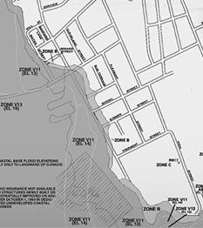
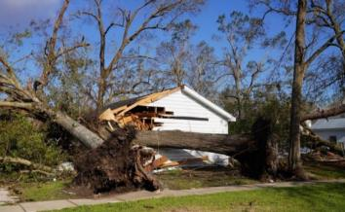
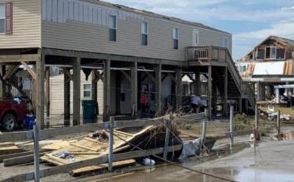
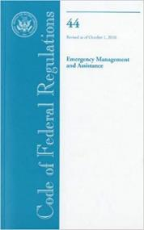
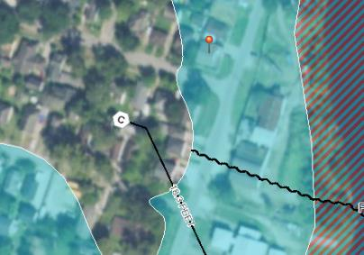
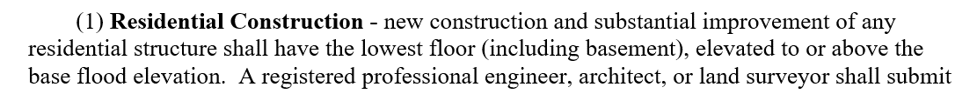
NFIP-participating communities are required to adhere to locally-adopted regulations to remain in good standing with the NFIP
Note: In coastal zones, the lowest horizontal structural member must be elevated to or above the BFE.
The State of Louisiana gives parishes and municipalities the ability to regulate floodplain development: Louisiana State Legislature, RS 38:84
Notes:
Susan
NFIP-participating communities are required to adhere to their locally-adopted regulations to remain in good standing with the NFIP.
I’ll go over some basic floodplain management regulations and how they affect recovery. You can see flood maps here, to the right. The dark shaded area denote areas of high flood risk. Communities in the National Flood Insurance Program agree to adopt and enforce minimum federal floodplain regulations that aim to help protect people and their property in these areas. Anything that’s built new, or improved in these areas needs a local floodplain development permit to ensure it meets basic protection standards or higher levels of protection if a community has adopted more safe regulations.
This includes local floodplain permits for repairs after a disaster. No matter the source of damage—not just flood damage. Here we see a tree damaged a home in a high risk flood area. And here we see wind damage to a home along the coast. Both of these homes should be quickly assessed for damage by the local community after a disaster and issued a floodplain permit that either allows temporary or minor repairs to the structure or in some cases major mitigation requirements.
One of those requirements is shown here. It’s a federal standard, that’s adopted or made more stringent by every NFIP participating community—in their local flood prevention ordinance. New construction and improvements require that the lowest floor be elevated to or above the base flood elevation. New construction is easy to picture, but what exactly is “substantial improvement?”
In NFIP Participating communities, Structure owners need to get a local floodplain development permit, and possibly an inspection before repairing and rebuilding.
If a home is determined to be substantially damaged or will be substantially improved by the local community, the community may only allow minor repairs until the time the structure can be mitigated. Quickly and efficiently notifying citizens of rebuilding requirements can save them money and heartache in the long run.
SD/SI is also in the flood provisions of the International Codes!

Slide 12
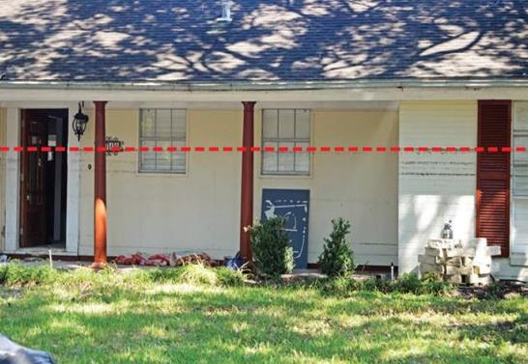
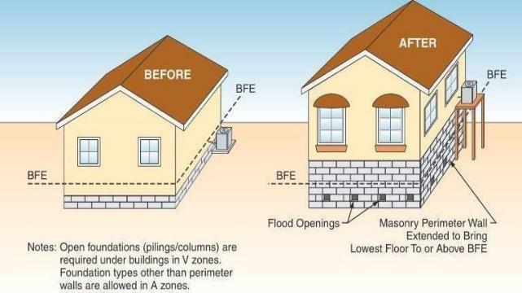
What is Substantial Improvement (SI)/Substantial Damage (SD)?
SD/SI structures
All costs to repair or improve ≥ 50% of pre-damage/pre-improvement market value
Damaged by any source or improved
Below Base Flood Elevation (BFE)
SD/SI structures must come into compliance post-event
Elevate, demo/rebuild, relocate
Notes:
Susan
BREAK CYCLE OF REPEAT FLOOD DAMAGE! KEEP PEOPLE AND PROPERTY SAFE!! SD structures are the most damaged, most at risk structures in your community.
Pic from the Harvey MAT report: This picture shows an approximate 5-foot High Water Mark (HWM) in Harris County Zone AE.​
Many older buildings built before communities joined the NFIP and began regulating SFHA development were inundated 3 to 6 feet, while newer elevated residential buildings performed much better (in some cases no inundation or less than a foot of flooding).​
Explain what SD is.
Below BFE and in the SFHA
Cost to repair >= 50% of market value
Homes are damaged, they can’t simply rebuild. We have a data driven approach, water to the doorknob estimation procedures
We need them to come into compliance so they can afford their NFIP premiums
So what is substantial damage? It’s commonly called the 50% rule. It’s when the total cost to restore or improve a structure to it’s pre-damaged or pre-improved condition is greater than or equal to 50% of the pre-damage or pre-improvement market value. It’s in every NFIP-participating community’s ordinance, and it’s an important way to break the repeat cycle of flood damage. It’s a way to build or rebuild safe, sustainable and resilient communities. These are our most-damaged, most at risk structures. Putting your family, your kids, your grandparents, your pets back in harm’s way—people and property.

Slide 13
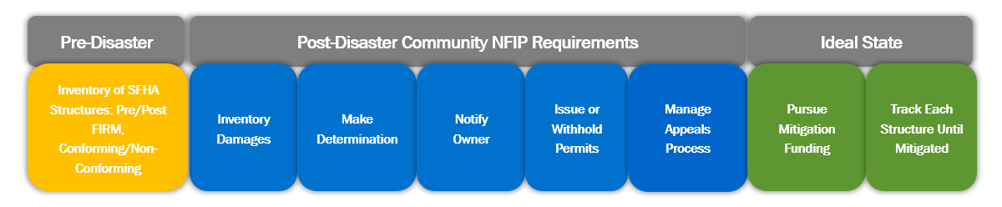
Community Pre- and Post-Disaster Process
FEMA’s free Substantial Damage Estimator (SDE) 3.0 Tool can help with damage inventory and calculating the information needed for a determination.
Need help doing floodplain damage assessments? Reassign staff, use a contractor, request mutual aid. Agreements and contracts take time to secure following federal procurement.
Notes:
Susan
Pre-Disaster: Inventory of SFHA Structures: Do this before a disaster hits.
Post Disaster:
1. Inventory/Inspections: Can be as simple as driving your regulated floodplain, connecting with your emergency manager or building official about damage data that’s already available to you. If you can document that the structure is already compliant—for example, lowest floor is elevated above BFE
2. Determinations: Math
3. All property owners notified of SD determination/Letters!: Having this official substantial damage determination can help with the benefit cost analysis for grant applications, and it opens up to $30,000 in Increased Cost of Compliance (ICC) funding for NFIP-policyholders who have primarily flood-related losses and must come into compliance with the community’s flood damage prevention ordinance.
4. Issue or withhold permits—note if your community allows temporary occupancy permits, make sure they have an expiration date and include exactly what minor repairs can be made and what repairs cannot be made. Inspect and renew them per your guidelines.
5: Appeals process in place – you can accept documentation, but never overturn a determination unless you receive more detailed and adequate information than what was used for the determination. Just because an owner brings you documents showing they are going to do less repairs, or a non-itemized cost estimate does not mean you should accept that.
6: Pursue mitigation funding:
NFIP Increased Cost of Compliance
FEMA Hazard Mitigation Grant Program (HMGP
Building Resilient Infrastructure and Communities (BRIC)
Flood Mitigation Assistance (FMA)
Other federal or state mitigation dollars/loans, HUD CDBG-DR, SBA Mitigation addition to loan, etc.
7: Track each structure until mitigated—some communities will even put a lien or notice on the title, until such time the structure is mitigated
FEMA and/or the state NFIP Coordination office at TWDB will ask you for:
Current status of all SD determinations
Complete list of all SD and list of all that weren’t SD
Math is shown for all determinations (to include supporting documentation)

Slide 14
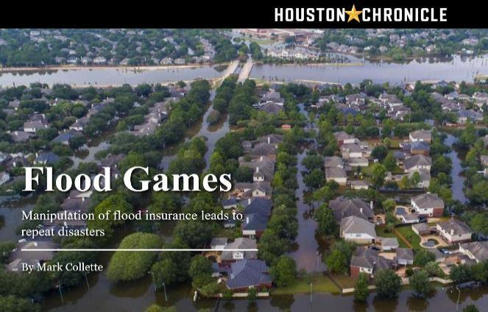
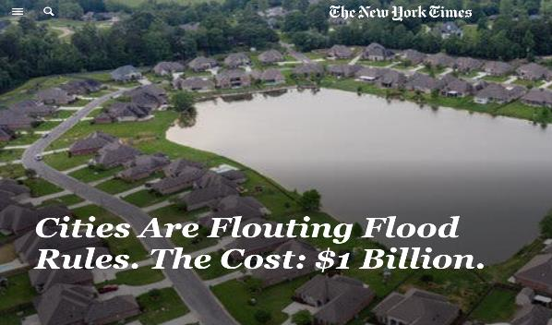
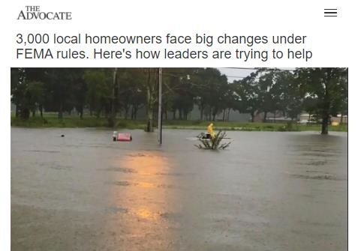

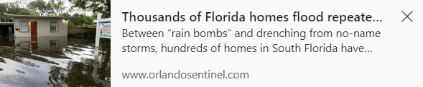
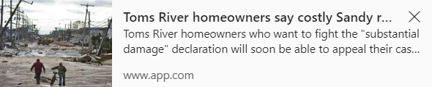
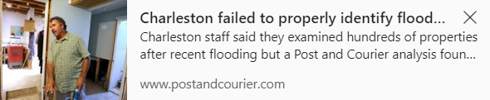
News Articles about SD
Notes:
Rebecca

Slide 15
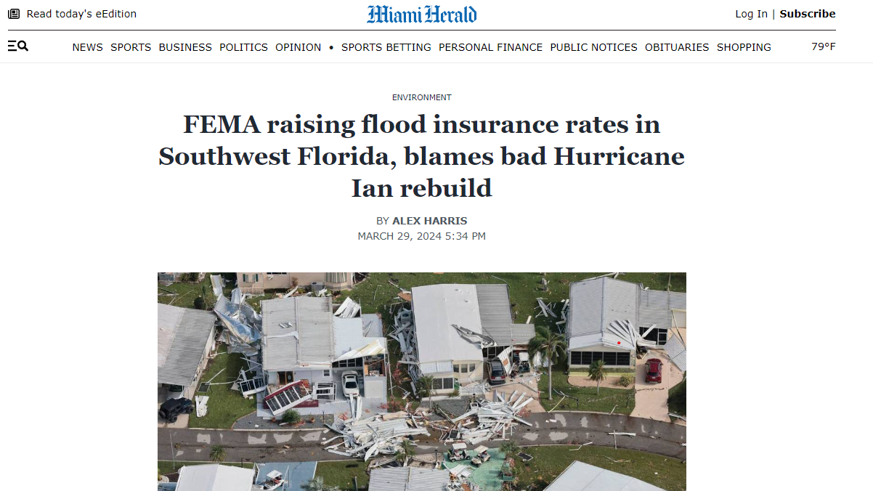
Hurricane Ian in Florida CRS Possible Retrogrades
FEMA said the problems began shortly after the storm, when federal teams visited the communities hit the hardest and looked at the properties, they thought were most likely to be substantially damaged, including older homes built in flood zones, some with previous flood damage.
“What the team found, unfortunately, is there was a lot of unpermitted work, lack of documentation,” said Robert Samaan, the regional administrator for FEMA’s Region 4, including Florida.
FEMA shared with the Herald three letters it sent Lee County in 2023. The December letter specifically requested the status of 590 properties before Jan. 12, noting the county would otherwise lose its flood discounts.
“Nobody wanted to get to this point, but unfortunately this is where we’re at with this,” said Samaan, the FEMA regional administrator. If Lee and the other municipalities don’t proactively work with FEMA to address these issues, he said, they could be kicked out of the flood insurance program altogether.
Lee County flood insurance prices rise after storm rebuilding | Miami Herald
Lee County flood insurance prices rise after storm rebuilding | Miami Herald
Notes:
Rebecca

Slide 16

SI/SD requirements are a proven & effective way to reduce future flood losses
When homeowners are already doing repairs or improvements, this opens the window of opportunity to repair using more resilient standards
Helps protect people and property
Helps avoids issues for residents selling the structure in the future
Helps open up mitigation funding opportunities
“[Pat] Forbes [director of the state Office of Community Development] noted that all homeowners who had a "substantial damage" letter from their local government when they applied for Restore money "had their homes reconstructed and elevated to the appropriate levels." Advocate News Article 5-17-21
Notes:
Rebecca
Why focus on SI and SD?
Substantial improvement requirements are a proven and effective way to reduce future flood losses
Disasters have huge impact on the built environment, and SI/SD requirements provide an opportunity to change the landscape to make communities more resilient.
If you are going to make a major investment in your home, we want to protect those investments by reducing the flood risk.
At the beginning of the NFIP (National Flood Insurance Program) in the 1960s and 70s, there was a belief that eventually all existing structures would be improved or repaired and would need to come into compliance with floodplain management standards.

Slide 17
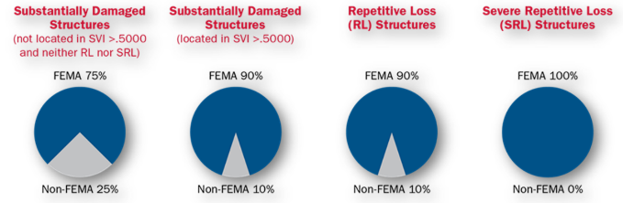
FEMA Mitigation Grant Programs
Pre-Disaster Mitigation Grants
  Flood Mitigation Assistance (FMA) grant
  Building Resilient Infrastructure and Communities (BRIC) grants
Post-Disaster Grants
  Hazard Mitigation Grant Program (HMGP)
  FMA Swift Current
HMA BCA Waiver for Riverine Acquisition of SD Structures Page 115
NFIP Policyholders who have a flood loss, get the community’s SD letter, and are eligible can assign their benefit of up to $30,000 for Increased Cost of Compliance (ICC) to their community. FEMA will count the ICC claim monies as non-Federal matching funds when applying for mitigation grants.
Notes:
Rebecca
FEMA administers Hazard Mitigation Assistance (HMA) grants to provide funding for eligible mitigation measures that reduce disaster losses. This can reduce the vulnerability of your community, promote community vitality, lessen response and recovery resource requirements, and result in safer communities.
Pre-disaster mitigation grants include:
Flood Mitigation Assistance (FMA) grants
Building Resilient Infrastructure and Communities (BRIC) grants
Both of these involve steps to reduce risk from floods or other hazards. Local communities are considered “sub applicants” of their state.
Post-disaster grants include:
The Hazard Mitigation Grant Program, or HMGP, including HMGP Post-Fire
These grants are for long-term hazard mitigation planning and projects and become available following a Presidential disaster declaration. Again, local communities are considered sub-applicants of their state.
There is also the new FMA Swift Current grant. It is supposed to help NFIP-insured survivors be able to get mitigation dollars sooner after a disaster, when the funding is open for your state/area.
Eligible activities for these various grants include:
Acquisition and demolition or relocation;
Elevation;
Enhancing floodplain management programs;
Minor or major physical localized flood reduction projects; and
Dry floodproofing, in some circumstances.
It is important to note that this funding can be used for repairs, but not for SI/SD activities like conducting assessments.

Slide 18
Examples of the Reimbursement
Around the country and in Louisiana. How did it go and what could improve?
Notes:
Nathan & Eddie
Show them examples of this reimbursement from around the country—focusing on the Louisiana examples we have from DR-4606 Spring Storms and DR-4611 Ida.
What went well for the parishes and communities that got the reimbursement? What could they do differently next time?

Slide 19
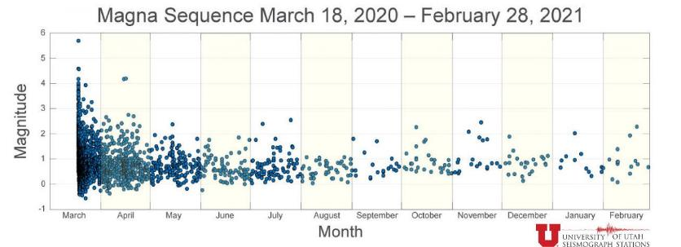
DR-4548 Earthquake and Aftershocks in Utah (90%/10%)
#181745, Salt Lake City: Many buildings were damaged by the Magna earthquake and needed to be inspected for public safety. (Building Permits, Field Surveys) Permitting staff worked overtime.
Obligated: $45,593.13 federal share, $5,065.90 non-federal share.
NOTE: Building Safety Inspections are eligible Under PA Cat B Emergency Protective Measures!
https://earthquakes.utah.gov/magna-quake/#gallery-image/1
Notes:
Nathan & Eddie
The next couple of slides will talk about 1206 being utilized- 1206 Enhance compliance with state and local building codes and floodplain management ordinances by providing state, tribal, and local government additional resources to carry out required activities after disaster.
An Example of the Building code reimbursement side of this policy is,
Remind the audience that Building code safety inspections specifically may be able to be reimbursed through PA Emergency Work, which may be declared sooner, and sometimes gets an additional federal cost share.

Slide 20
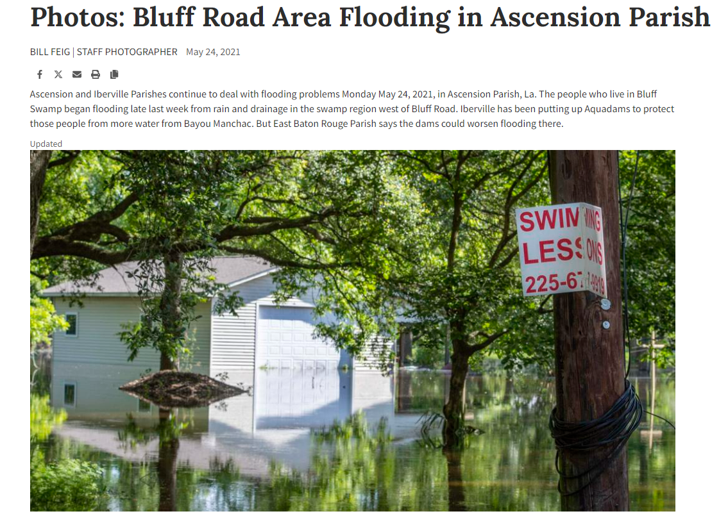
DR-4606 Louisiana Severe Storms, Tornadoes, and Flooding (90%/10%)
#542865, Ascension Parish: Ascension Parish Government procured a contractor to inspect structures parish wide for substantial damages, in the aftermath of the severe storms, tornados, and flooding that occurred May 17th-21st. The contractor inspected 60 damaged structures.
Obligated: federal share $16,740.00,
non-federal share $1,860.00
Photos: Bluff Road Area Flooding in Ascension Parish | Photos | theadvocate.com
Notes:
Nathan & Eddie

Slide 21
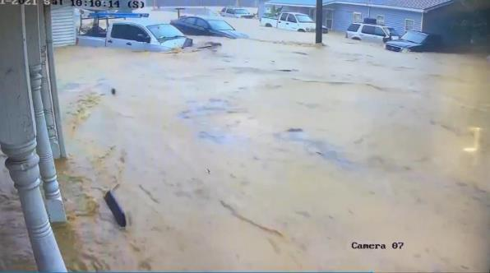
DR-4609 Flooding in Tennessee (90%/10%)
#542801, City of Waverly: Had widespread flooding damage that destroyed hundreds of homes. City of Waverly hired a temporary employee to provide assistance in building code and floodplain administration and enforcement, including inspections for substantial damage compliance. 226 Force Account Labor Regular Hours For Temporary Employee.
Obligated: federal share $4,068.00, non-federal share $452.00
https://www.tennessean.com/story/news/local/2021/09/02/video-shows-how-fast-water-rose-waverly-tennesee-floods/5699548001/
Notes:
Nathan & Eddie

Slide 22
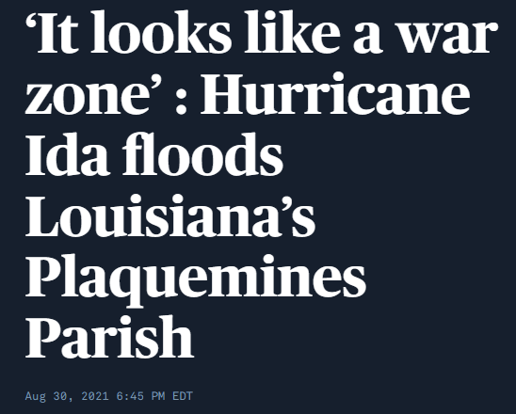
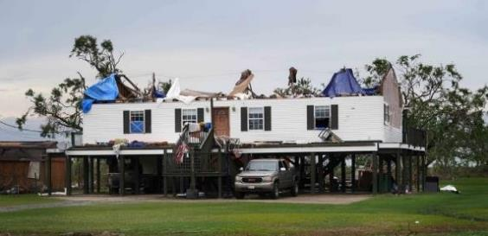
DR-4611 Hurricane Ida in Louisiana (90%/10%)
Obligated:
#664526, Town of Lutcher: The applicant utilized contract services for structure inspections to 1,823 properties and buildings in order to enforce floodplain management ordinances
  federal share $75,056.45, non-federal share $8,339.60
#664357, Town of Gramercy: The applicant utilized contract services for damage inspections to 1,763 town-wide private properties and buildings
  federal share $70,526.97, non-federal share $7,836.32
#663823, St. James Parish: Contract services for structure inspections to Parish-wide private properties and buildings in order to enforce floodplain management ordinances. Contract included rapid windshield surveys; SDE input; SD notifications, outreach and coordination
  federal share $247,359.20, non-federal share $27,484.35
#665540, Plaquemines Parish: Hurricane Ida caused extensive damage to homes in Plaquemines Parish, requiring additional resources for building code and floodplain management administration and enforcement. Contractor assessed 9,345 properties and found 146 to have “substantial damage.”
  federal share $150,932.52, non-federal share $16,770.28
‘It looks like a war zone’ : Hurricane Ida floods Louisiana’s Plaquemines Parish | PBS NewsHour
Julie Joseph, FEMA
Notes:
Nathan & Eddie

Slide 23
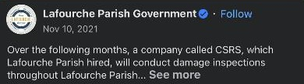
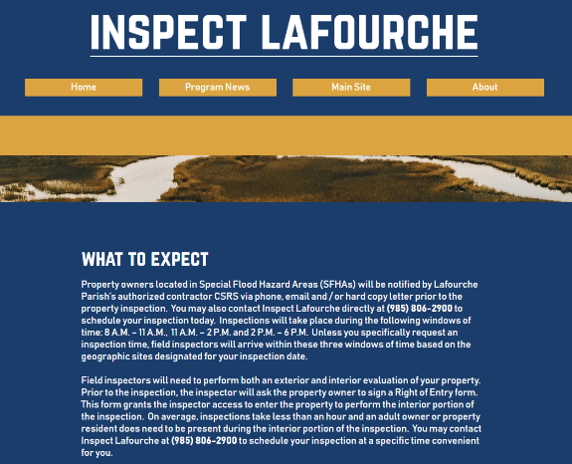
DR-4611 Hurricane Ida in Louisiana (90%/10%), Continued
Obligated:
#673572, Jefferson Parish: Jefferson Parish initiated inspections for substantial damage compliance to enforce its floodplain management ordinances. The Parish contracted the services performed which included the Town of Jean Lafitte; the Town of Grand Isle; and the unincorporated areas of Lafitte, Barataria, and Crown Point within Jefferson Parish.
  federal share $399,179.46, non-federal share $44,353.27
#674667, City of Kenner: The applicant procured contract vendor to provide floodplain management and technical support services to accurately document incurred damage and provide FEMA substantial damage determinations as required by the local floodplain management ordinance for participation in the NFIP. There are a total of 296 sites.
  federal share $145,161.00, non-federal share $16,129.00
#668699, Lafourche Parish-wide: The Applicant performed 1206 Substantial Damage Assessments within their designated Parish utilizing contract and Force Account Labor/Equipment. The contract work consisted of: 1-Homeowner Coordination ($2,374,275.00), 2-Assesssments & Quality Control ($592,313.75), 3-I Data Management ($853,346.25), and 4-Community Outreach ($31,162.50). The results of the Substantial Damage determinations were: 18,497 total homes were inspected; Damaged Less Than 50% was 16,985 (91.83%), Damaged 50% or more 1,512 (8.17%).
  federal share $7,138,235.25, non-federal share $793,137.25
Home (inspectlafourche.com)
Notes:
Nathan & Eddie

Slide 24
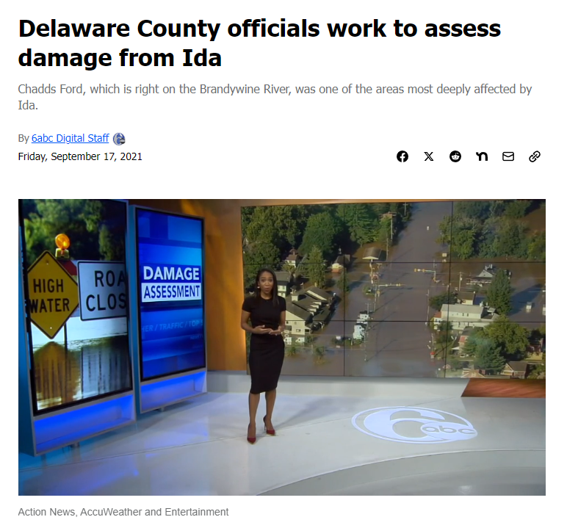
DR-4618-PA, Remnants of Hurricane Ida (90%/10%)
#660159, Chadds Ford Township: The Township was inundated with flood waters causing the town to hire contractors to assist with Floodplain Assessments, Code Enforcement, and Building Inspections. Maryann is the manager who routinely performs these task, but due to the amount and the nature of the flooding the town hired 2 contractors to assist with this process.
Obligated: federal share $14,748.57, non-federal share $1,638.73
Delaware County officials work to assess damage from Ida near the Brandywine River in Chadds Ford. - 6abc Philadelphia
Notes:
Nathan & Eddie

Slide 25
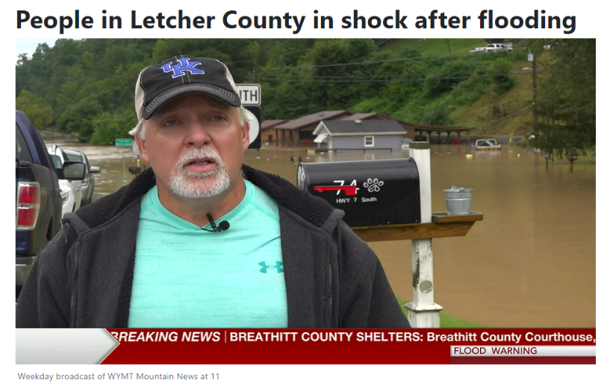
DR-4630-KY, Kentucky Severe Storms, Flooding, and Tornadoes (90%/10%)
#663352, Marshall County: This project is for contract work for inspecting structures and preparing substantial damage determinations in the aftermath of the tornadoes. The inspections are to ascertain the integrity of the structure beyond the obvious damage to determine if the home is structurally sound and can be repaired or needs to be updated to the current building code. The work has been competitively bid and the County has identified 196 buildings needing structural inspections.
Obligated: federal share $12,897.68, non-federal share $1,433.07
#714378, Letcher County: Severe Storm caused heavy rain, and flash flooding to all of Letcher County. Applicant hired contractor to assist with Floodplain permitting and other areas listed under DRRA 1206.
Applicant Signed Project: federal share $121,533.97, non-federal share $40,511.32
People in Letcher County in shock after flooding (wymt.com)
Notes:
Nathan & Eddie

Slide 26
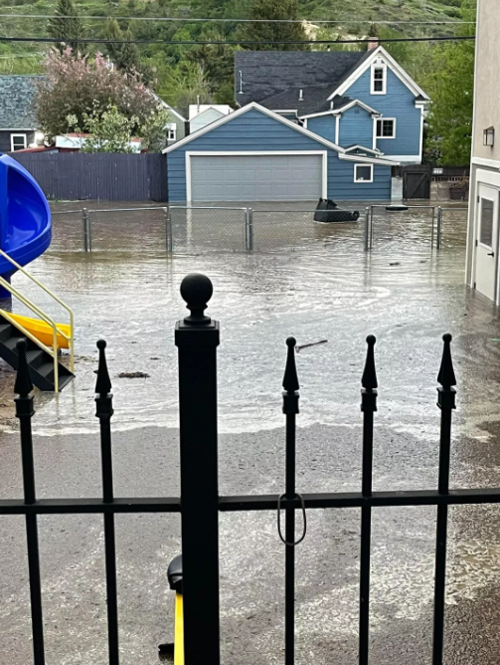
DR-4655-MT, Montana Severe Storm and Flooding (75%/25%)
#681466, Stillwater County: Prior to the June 2022 flooding event, the Applicant processed approximately 10 floodplain applications per year. Since the June 2022 flood event, the Applicant and its contractor have processed more than 100 floodplain applications. Activities include the review and processing of applications for floodplain permits, administration of standards in accordance with floodplain management regulations and providing information on floodplain map data and compliance to residents and property owners.
Obligated: federal share $77,778.01, non-federal share $25,926.00
Photo Gallery: June 2022 southern Montana flooding (kbzk.com)
Notes:
Nathan & Eddie

Slide 27
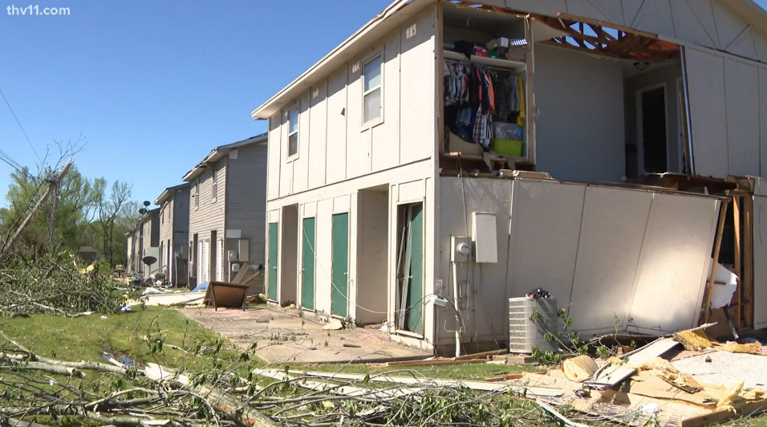
DR-4698-AR, Arkansas Severe Storms and Tornadoes (75%/25%)
#728040, City of Jacksonville: Develop substantial damage determination assessment on, 25 each of private properties and private buildings to verify compliance with the National Flood Insurance program, Tornadoes force wind, flying debris and severe storms, 100% work completed. Force Account Labor compiled time & activity to date ($3,347.49). Invoice from Surveyor (Contract Labor - $1,400).
Obligated: federal share $3,560.62, non-federal share $1,186.87
Jacksonville, Arkansas tornado update | thv11.com
Notes:
Nathan & Eddie

Slide 28
Working Together for Success
EMs and FPAs, Planning
Notes:
Emphasize how the local EM, local PA point of contact, and the floodplain administrator need to work together to ensure they are 1. Being a compliant NFIP-participating community through the disaster cycle, and 2. Can successfully access this PA reimbursement.
Share post-disaster substantial damage plans that are currently available, and ones underway at LADOTD.
Share that making a plan helps posture you to be able to get this PA reimbursement after a disaster. Plan now, get pre-positioned contracts or MOUs, make these connections in your community.

Slide 29
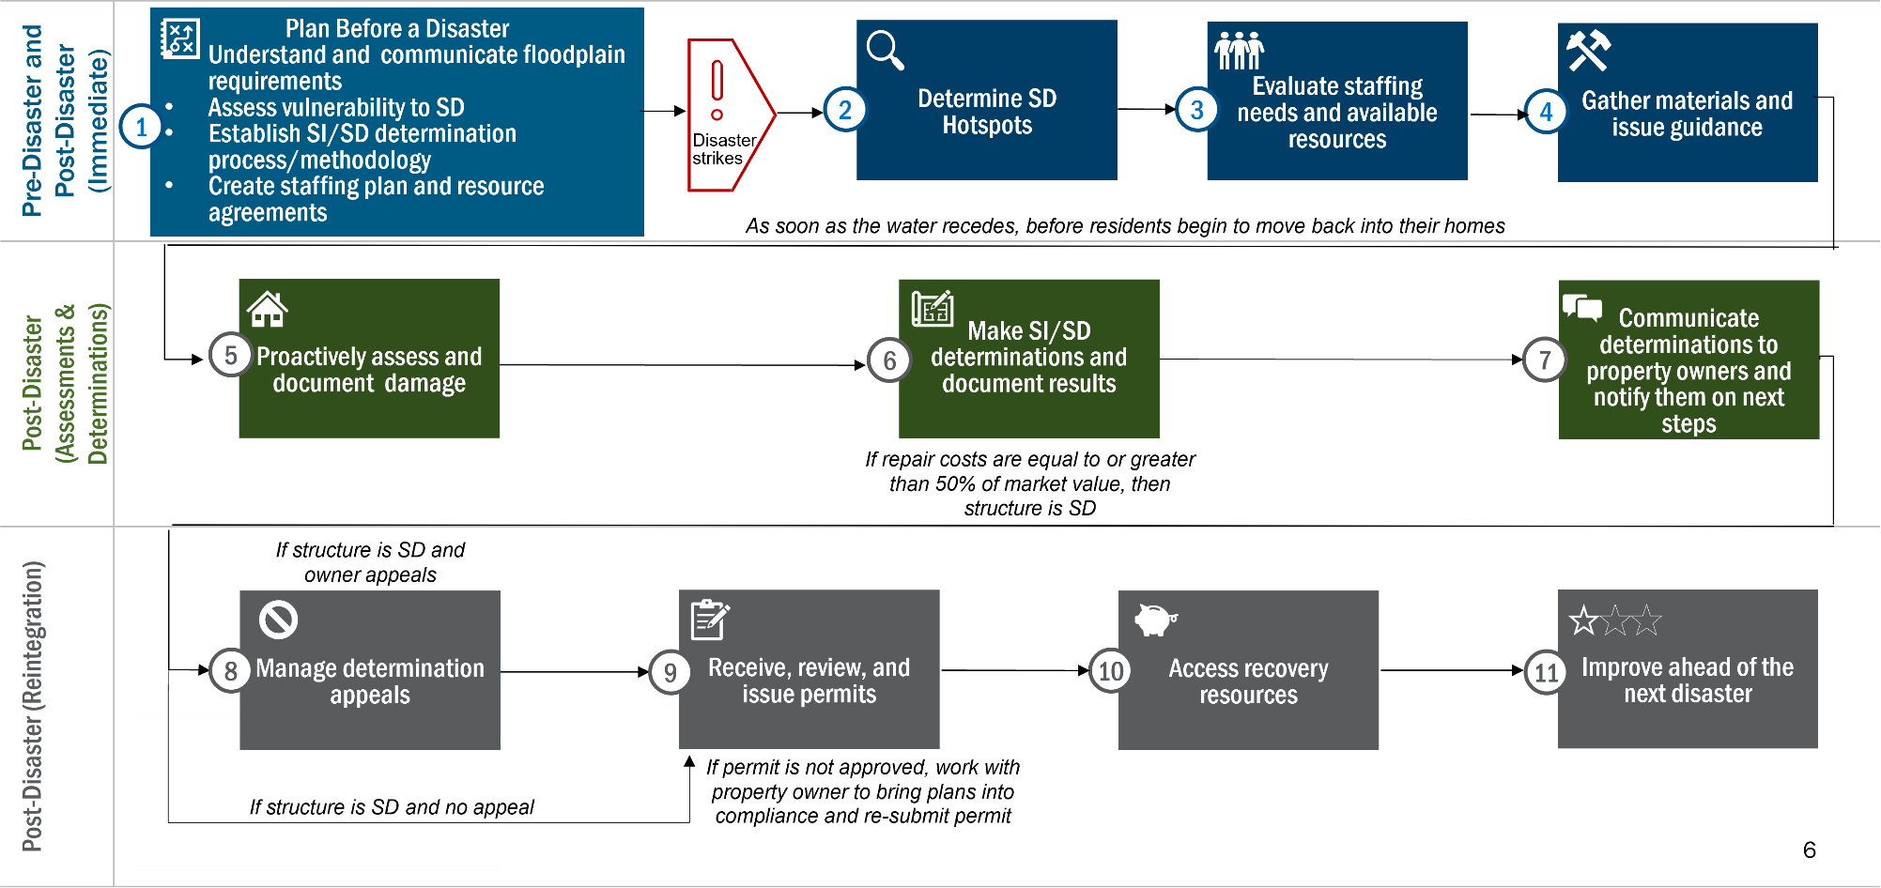
Pre-disaster planning avoids additional workload after disaster strikes
Notes:
Chad
By planning before a disaster, you can avoid scrambling to do all the things in the light blue box during disaster operations. This includes:
Understanding your SI/SD requirements through your community’s regulations and legislation and communicating floodplain requirements to local officials and the public;
Assessing vulnerability to SD; and
Establishing an SI/SD determination process and methodology.
For the immediate coordination after a disaster, this includes:
Determining SD hotspots, the areas that are likely impacted based on operational information;
Evaluating staffing needs and available resources based on the amount of likely damage; and
Gathering materials and issuing guidance to staff to ramp up your SD mission.
Post-Disaster in the Assessments and Determinations phase, this includes:
Proactively assessing and documenting damage;
Making SI/SD determinations and documenting results; and
Communicating determinations to property owners and notifying them on next steps.
Finally, post-disaster reintegration is all about getting back to normal. Everything in gray boxes is about getting back to normal operations and incorporating determinations into the permitting process. This includes:
Managing determination appeals;
Receiving, reviewing and issuing permits;
Accessing recovery resources; and
Improving ahead of the next disaster.

Slide 30

That’s a lot to get done in 180 days
According to DRRA Section 1206 FAQ Volume 2, page 2: PA can reimburse costs for eligible work done starting on the first day of the incident period and up to 180 -days following the date the major disaster declaration is amended to authorize PA permanent work (refer to Section C, Eligible Costs, of the Building Code and Floodplain Management Administration and Enforcement Policy for more information).
Disaster | Incident Start Date | PA Major Dec. Date | +180 Days
Example 1 | 8/26/21 | 9/7/2021 | 3/6/2022
Example 2 | 5/17/2021 | 8/20/2021 | 2/16/2022
Make sure to report this in your list of impacts to FEMA within 60 days of the Recovery Scoping Meeting.
Notes:
Chad
6 months will go by fast. If you’re prepared to do your post disaster work, you’ll better be able to take advantage of the 180-day funding limit.

Slide 31
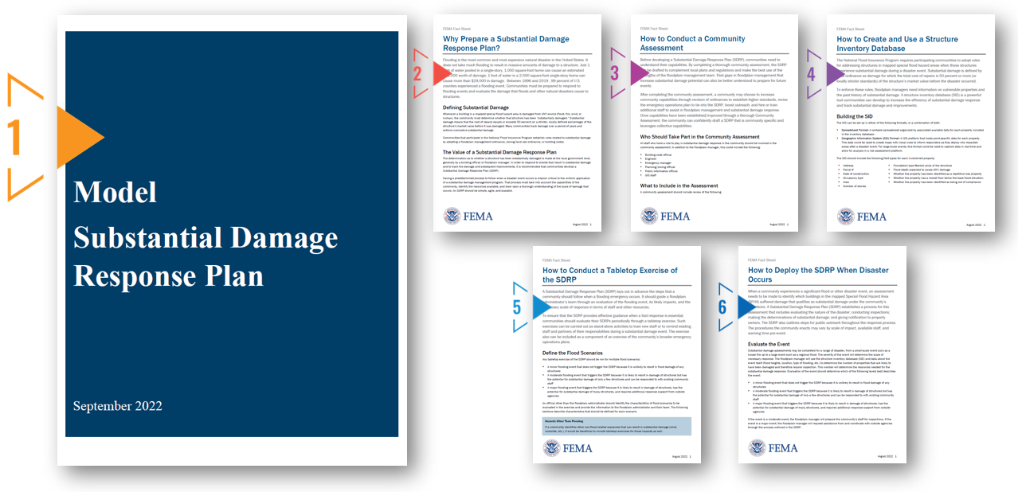

Prepare now, download and customize this SD Response Plan
Scan this QR code, or go to this link: https://fema.cosocloud.com/sdrp/
Enter your name to Join as Guest
Click "Ok" on Terms of Use
In the Downloads Pod, click the arrow to download each individual item, or click on the three dots to "Download All"
Notes:
Chad
You can download our Model Substantial Damage Response Plan, or SDRP, which you can edit and modify to your community’s needs. We also have five fact sheets we’ve created to help understand parts of the process. Fact sheets include:
Why Prepare a Substantial Damage Response Plan
How to Conduct a Community Assessment
How to Create and Use a Structure Inventory Database
How to Conduct a Tabletop Exercise of the SDRP
How to Deploy the SDRP When Disaster Occurs
Navigate to this link, or use your phone to scan this QR code to download resources and a modifiable SD response plan. . Enter your name to Join as Guest. Click "Ok" on Terms of Use. In the Downloads Pod, click the arrow to download each individual item, or click on the three dots to "Download All." If you’re on your phone, you can click on a link and bookmark it.
A PDF of these slides is also available in the downloads section.

Slide 32
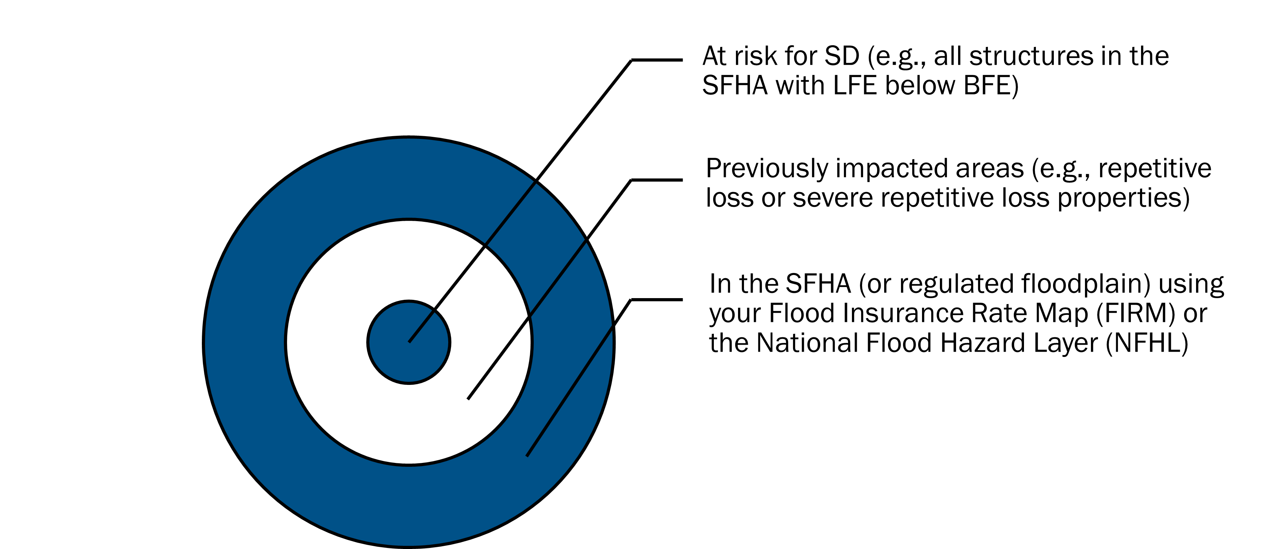
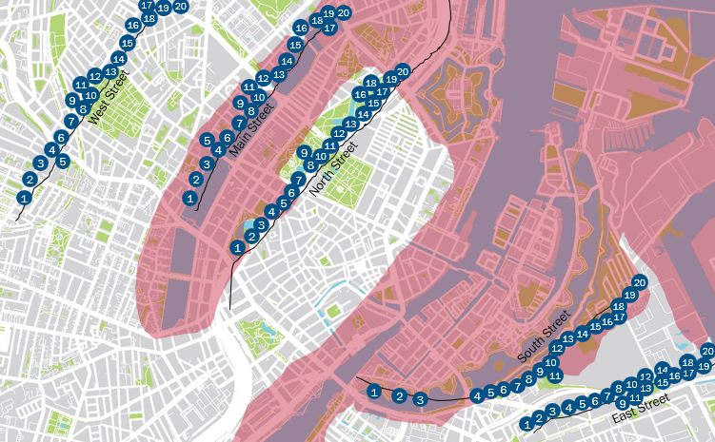
Identify areas vulnerable to SD, and prioritize inspections/assessments
Assume the pink area is the SFHA.
Would West Street and East Street be vulnerable to SD?
If South Street only got 1 inch of water, how would that help with your prioritization?
Notes:
Chad
Develop a list or property database of structures most vulnerable to SD.
Best practice: Pre-populate the SDE Tool

Slide 33
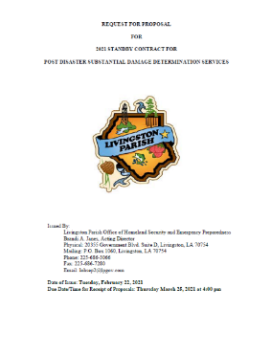
Best practices
Pre-disaster: Contract or MOU, MOA, IMAC, or EMAC ready
Consider establishing contracts and agreements with:
  Neighboring communities or communities in another part of the state
  Your parish
  Your state
  State Association of Floodplain Management
  Building Professional Organizations
  Third-party contractors
  Include in your scope of work:
  Lowest floor elevations on all inspected structures
  Help with the appeals process (including market value and repair costs documentation review)
Notes:
Susan
Communities regularly have post-disaster contracts
Contractors used frequently for Hurricane Ida in Louisiana
What GOHSEP and FEMA training are resources are available to Louisiana communities if they want to secure a pre-positioned contract?

Slide 34
Next Steps
Create a substantial damage plan or SOP if you don’t have one.
Floodplain administrators, building code officials, permit staff, emergency managers, local officials, and their Community Public Assistance point of contact (POC) should discuss their post-disaster assessment plan and this policy.
Have mutual aid agreements or contracts in place that meet state and federal procurement guidelines.
Create/update your inventory of structures in the special flood hazard area that are below base flood elevation. Pre-populate the SDE 3.0 Tool or other tracking software.
Offer regular substantial damage training to staff to ensure they are appropriately trained to accomplish tasks efficiently, communicate with the public, and ensure NFIP requirements are met.
Notes:
Susan

Slide 35
DRRA Section 1206 & Floodplain Management Resources
DRRA webpage
  Policy
  Policy FAQ1 Fact Sheet
  Policy FAQ2 Fact Sheet (includes more info like Cat. G and eligibility starting on 1st day of incident period)
  Companion Guide
DRRA Section 1206 for Building Code Administration and Enforcement
DRRA 1206 video
Answers to Questions About Substantially Improved/Substantially Damaged Buildings, FEMA 213
Substantial Improvement/Substantial Damage Desk Reference (fema.gov)
Substantial Damage Estimator Tool | FEMA.gov
Public Assistance - GOHSEP | Governor's Office of Homeland Security & Emergency Preparedness
LouisianaPA.com
Training:
Training from LADOTD Floodplain Office
YouTube FEMA Substantial Damage Estimator Training Modules
FEMA NFIP 101 Hosted by ASFPM, On Demand
E/L/G 273: Managing Floodplain Development through NFIP
IS-284: Using the SDE Tool
IS-285: Substantial Damage Estimation for Floodplain Administrators
FEMA Public Assistance YouTube Channel
Notes:
Rebecca

Slide 36
Contacts
Nathan Gary
Public Assistance Executive Officer
Governor’s Office of Homeland Security and Emergency Management
nathan.gary@la.gov
Susan Veillon
Statewide Program Manager 1
Louisiana Department of Transportation and Development, Floodplain Office
susan.veillon@la.gov
Eddie Williams
Public Assistance
Louisiana Lead
LIRO, FEMA Region 6
eddie.williams@fema.dhs.gov
Chad Ross, CFM
Floodplain Management & Insurance
Group Supervisor
LIRO, FEMA Region 6
chad.ross@fema.dhs.gov
Rebecca Dake, CFM
Training & Outreach Specialist
Floodplain Management & Insurance Branch
FEMA Region 6 Mitigation
rebecca.dake@fema.dhs.gov
Notes:
Rebecca

